Slide 1



Art Department

Slide 2
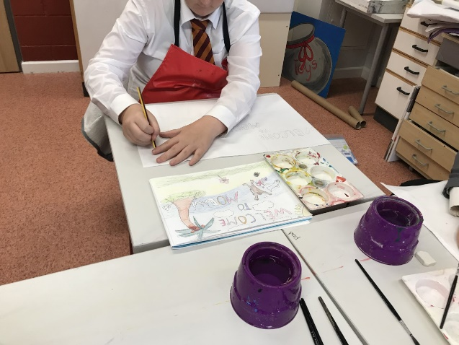
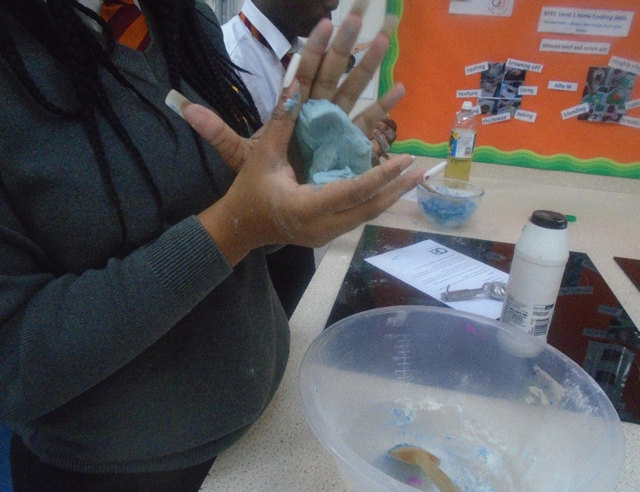
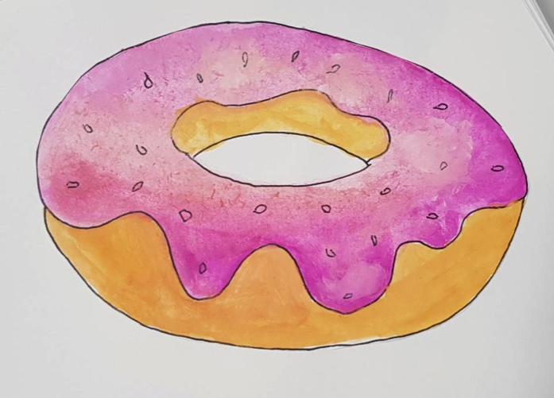

Why Art?
At Olive Academy Thurrock the Art curriculum is designed to inspire our students to grow their arts and leadership talents. We aim to support and encourage students of all levels and abilities and from all backgrounds and cultures to engage and participate in the arts.
We offer our students access to two qualifications:
Pathway 1: Art GCSE qualification.
Pathway 2: Arts Award certificates (Discover, Explore or Bronze levels).

Slide 3
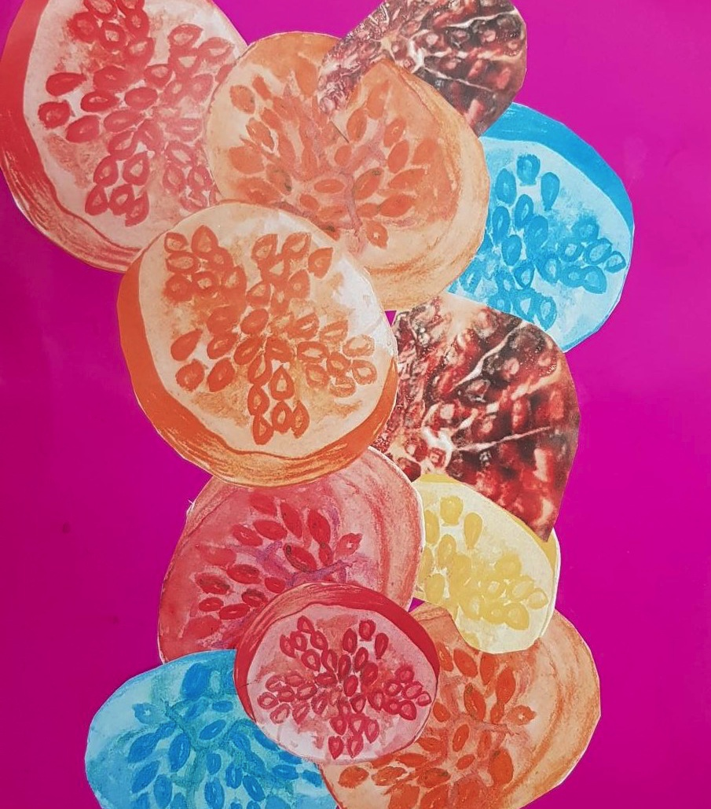
Art with KS4
(GSCE)

Slide 4
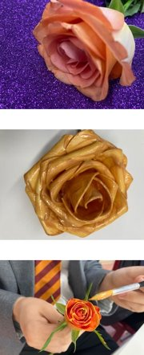
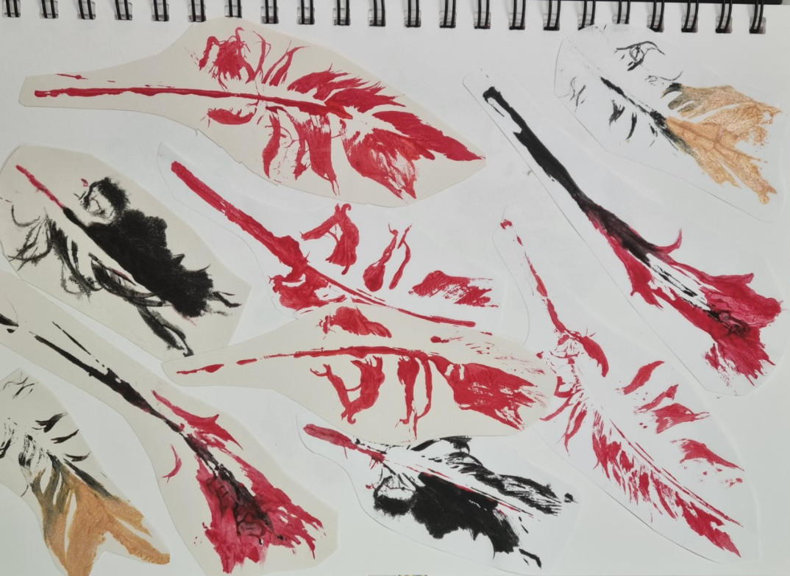

Slide 5

All students can work towards an Arts Award certificate.
Learners take on challenges in an art form, participate in arts activities, experience arts events, get inspired by artists and share their arts skills with others. They create an Arts Log (portfolio) to keep a record of their creative work and progress in a format of their choice.
Arts Award: Discover
Arts Award Discover provides a foundation level to introduce learners to the arts and is a springboard to other levels of Arts Award.
Arts Award: Bronze
Bronze Arts Award aims to enable learners to develop an understanding of arts practice and some knowledge of arts provision in the community. Learners need to commit to taking part in creative activities and to demonstrate effective, basic communication skills and an ability to convey information.
Learners do this by taking an active part in arts activities as well as experiencing the arts as audience members. They research an artist/craftsperson who inspires them and develop their leadership skills through passing on their arts skills to others.
Arts Award: Explore
Arts Award Explore aims to enable learners to develop a basic understanding of a range of art forms, artists and arts organisations, to commit to taking part in arts activities and to demonstrate basic communication skills. Learners do this by taking part in different arts activities and recording what inspires them, experiencing the work of artists and arts organisations, creating art work and presenting their exploration to others.

Slide 6
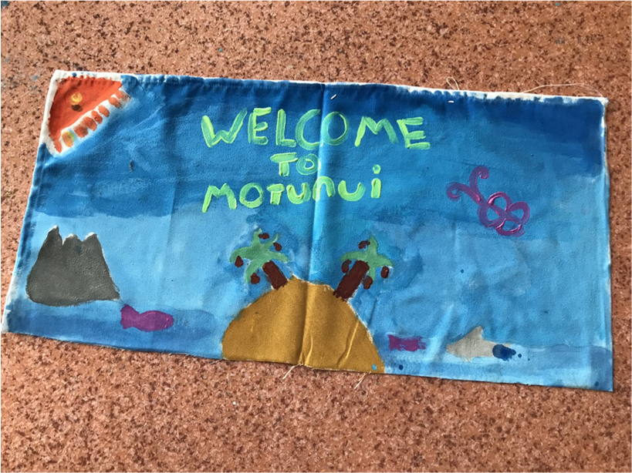
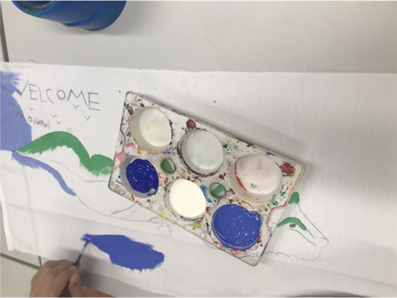
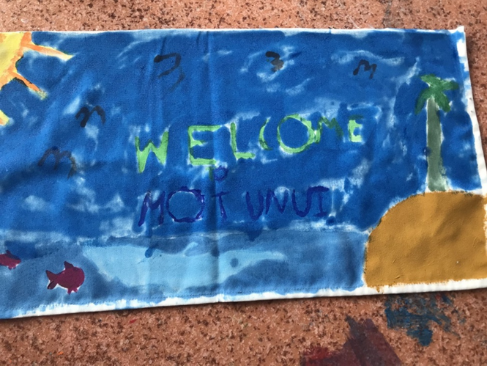
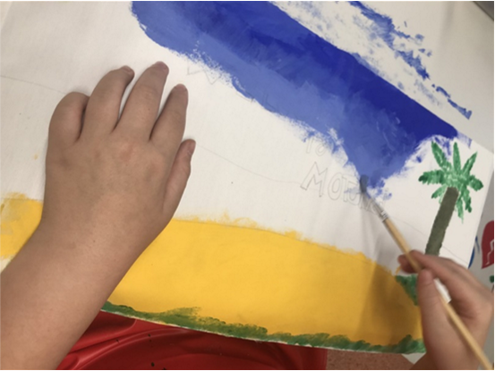
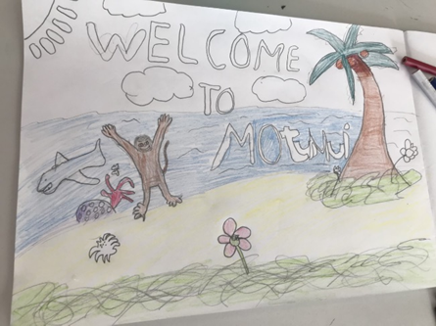
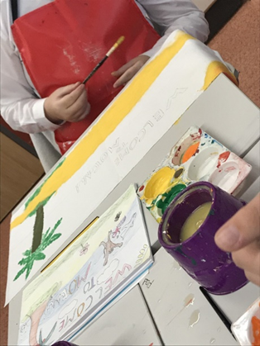
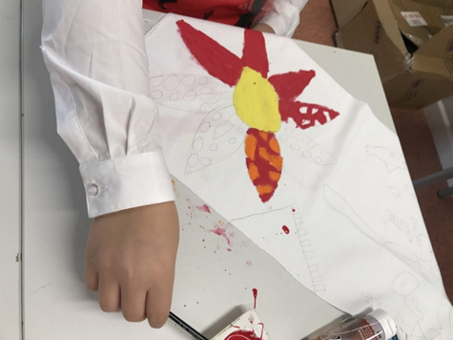
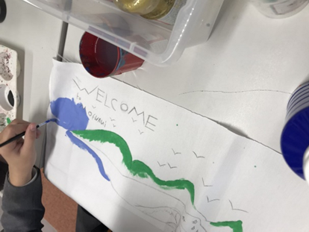
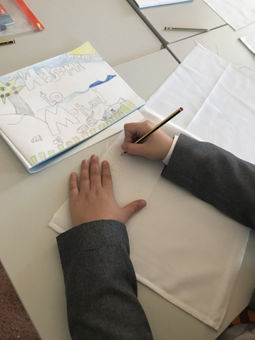

We welcome you to Motunui! Look at our fantastic banners; designed using inspiration from Moana and the Polynesian culture.

Slide 7
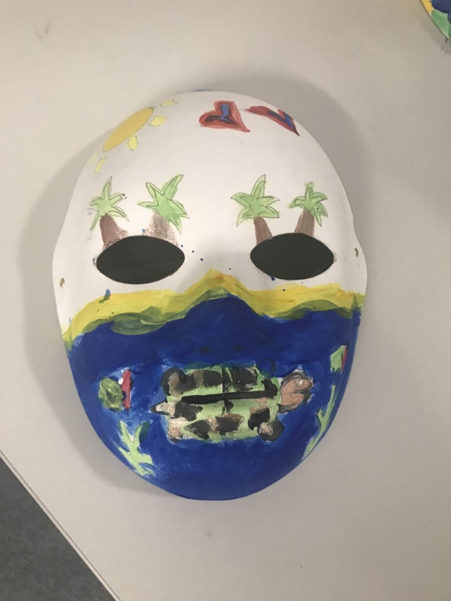
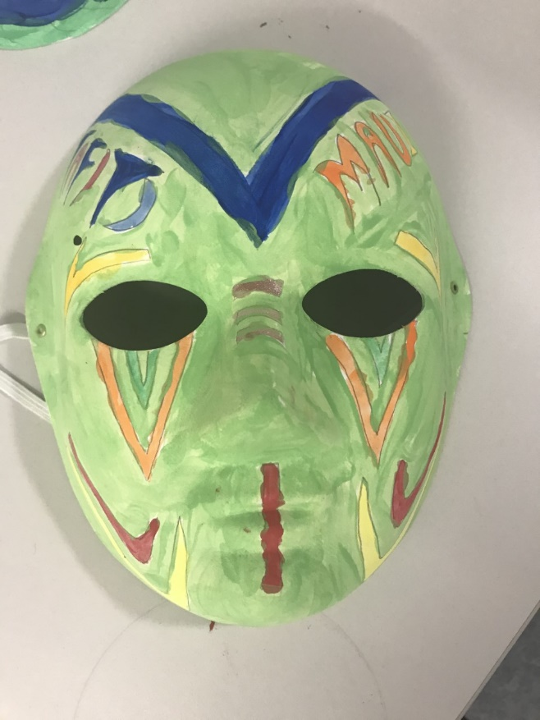
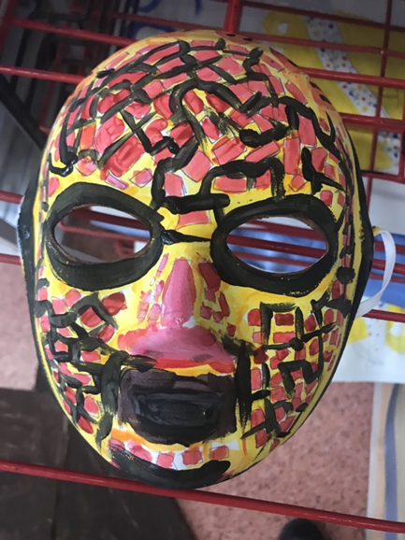
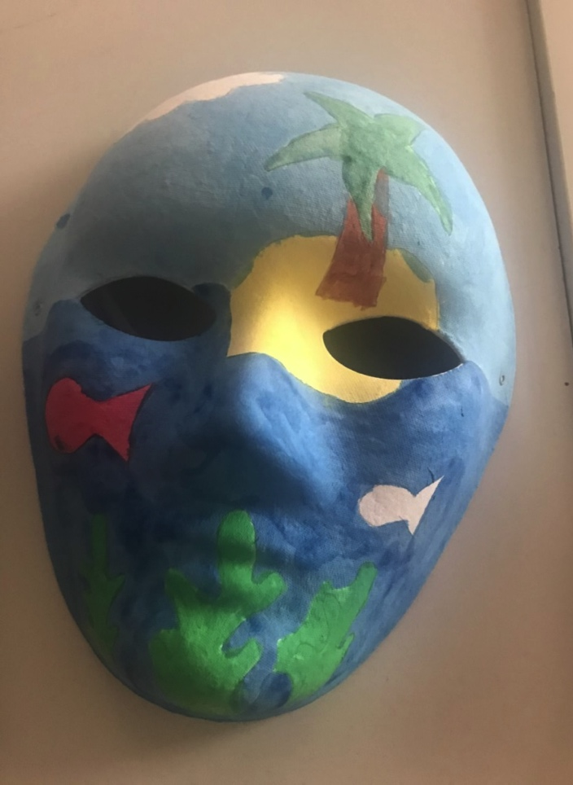
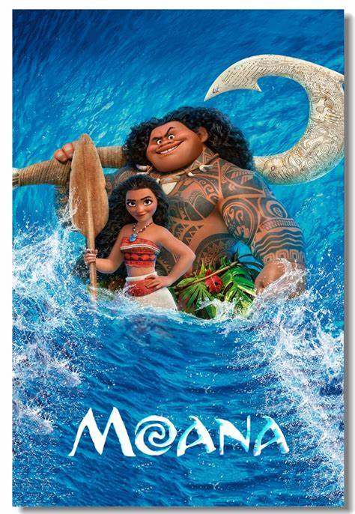
Arts Award: Explore
Using the film Moana as inspiration, students have learnt about the Polynesian people and their culture.
Look closely at our masks – what do they tell you about the Polynesian people?

Slide 8
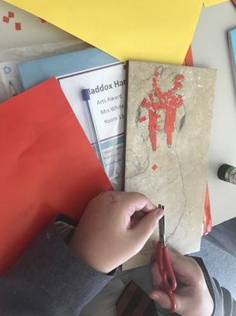
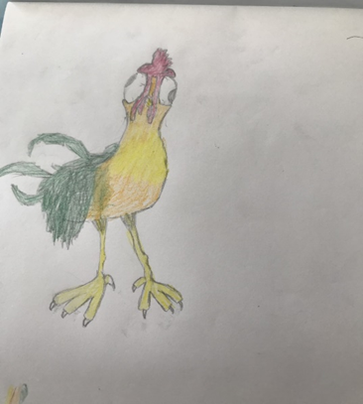
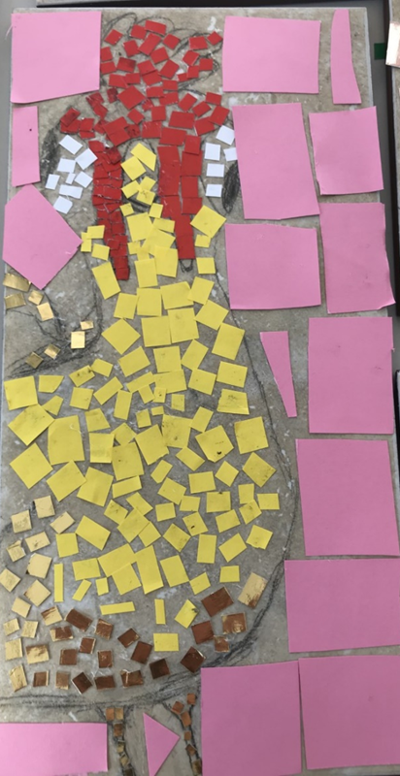
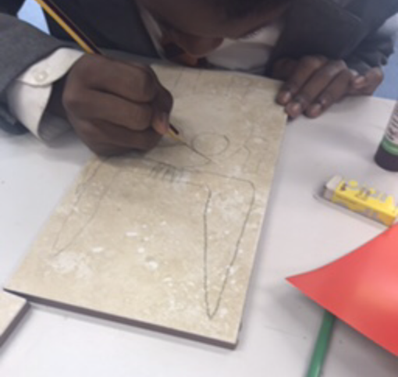
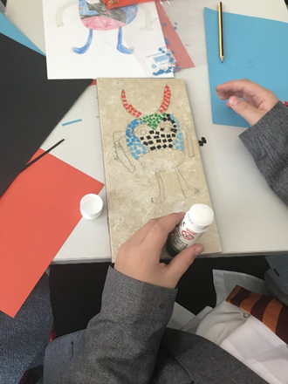
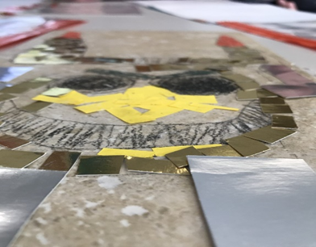
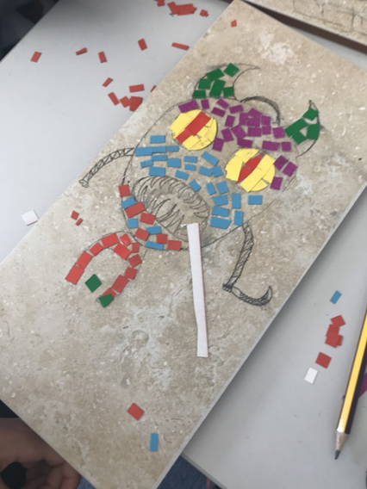
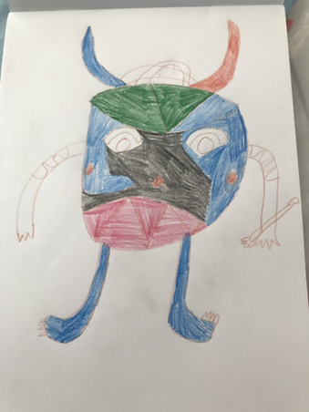
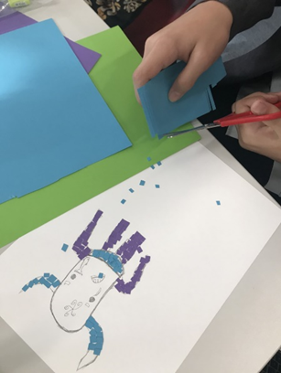
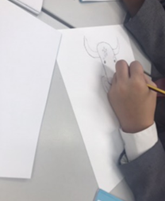

Moana themed sketches and mosaics.
Students used characters from the film and created multi-coloured card mosaics.

Slide 9
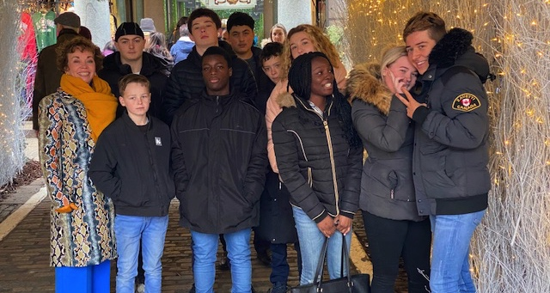
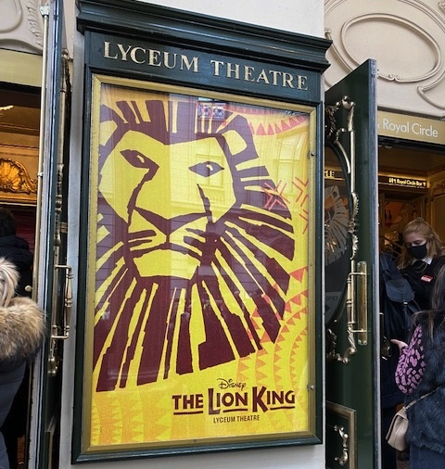
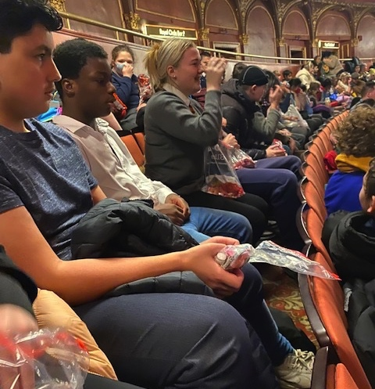
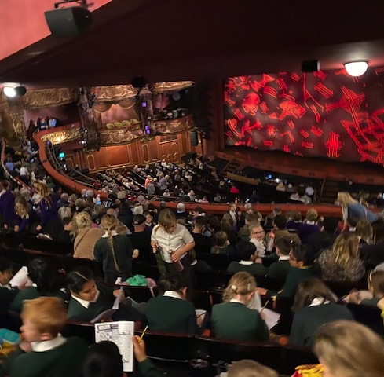

Students enjoyed a trip to the theatre!

Slide 10
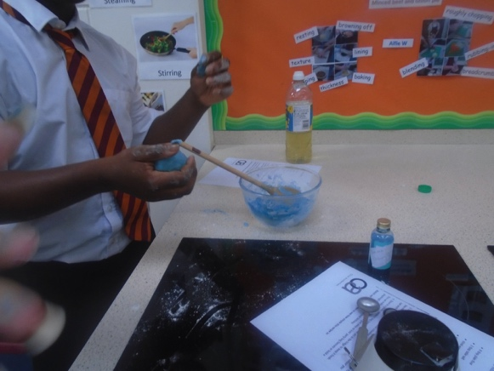
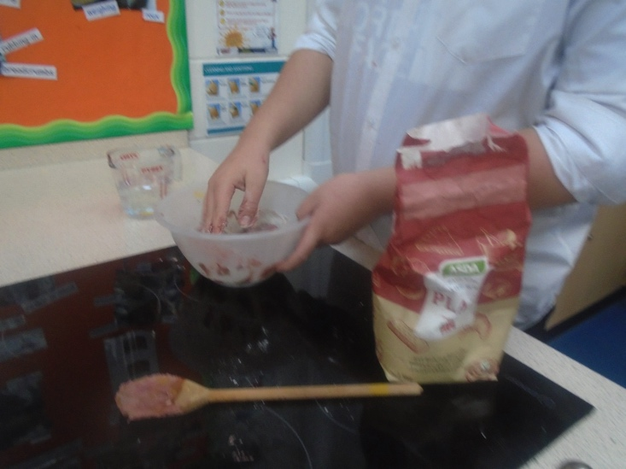
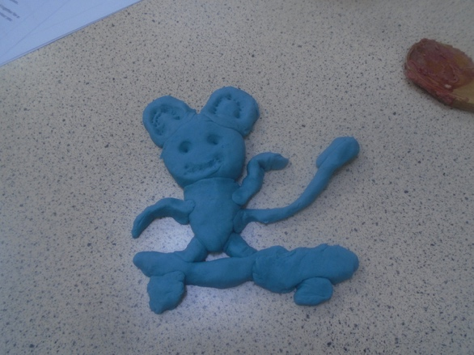
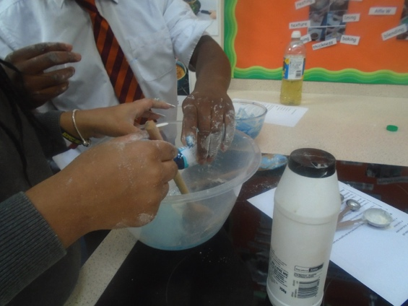
We made our own playdough!

Slide 11
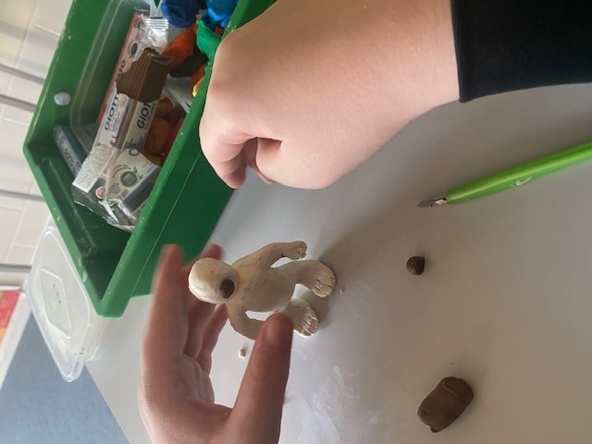
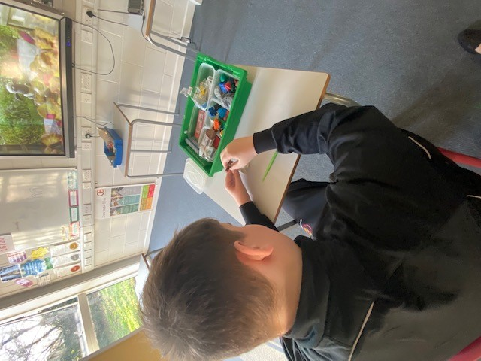
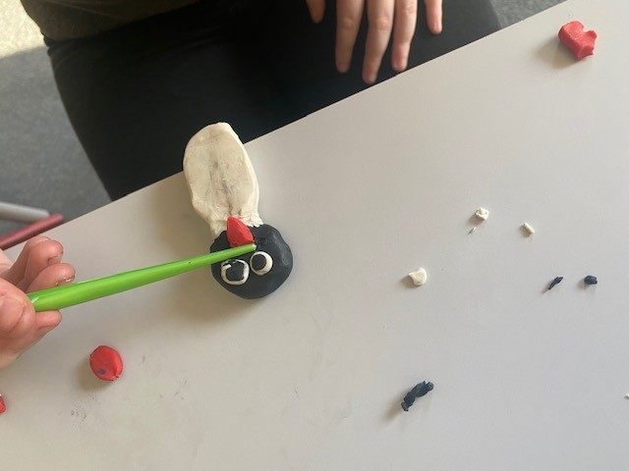
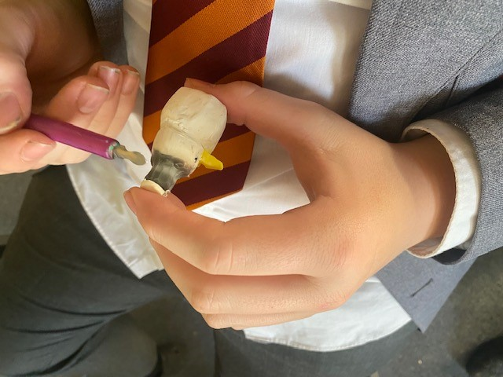
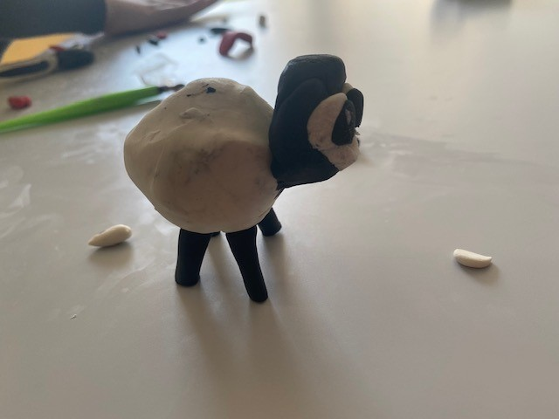
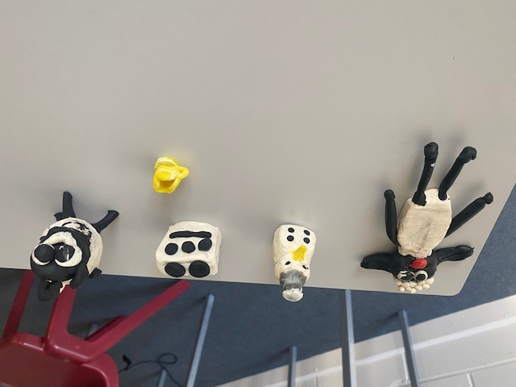
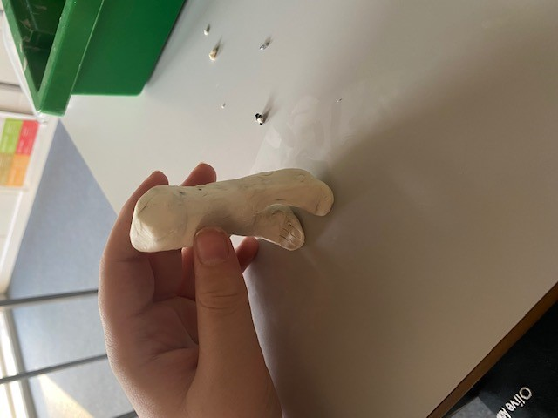
Stop Motion Animation
We created characters and then recorded short clips to produce a small film

