Slide 1



Art Department

Slide 2
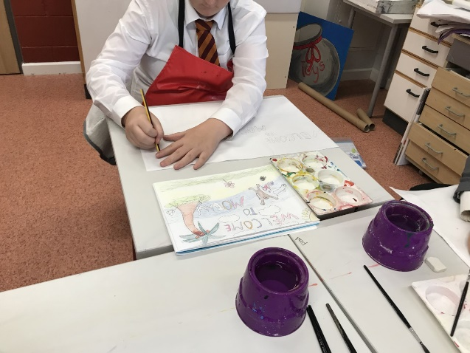
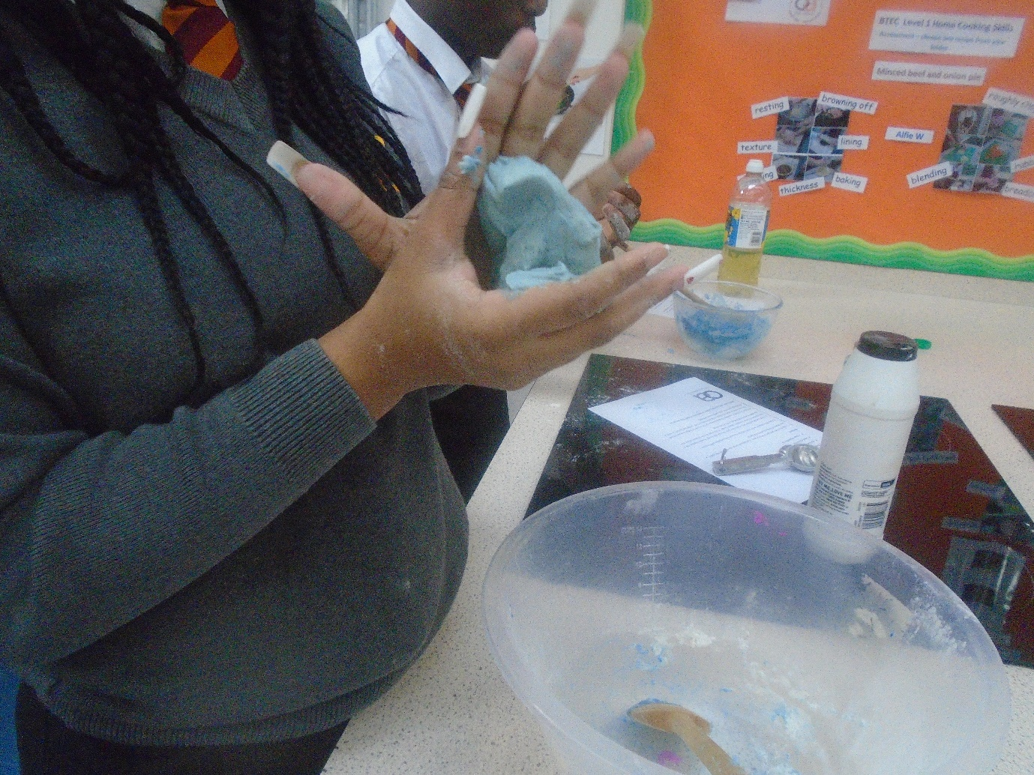
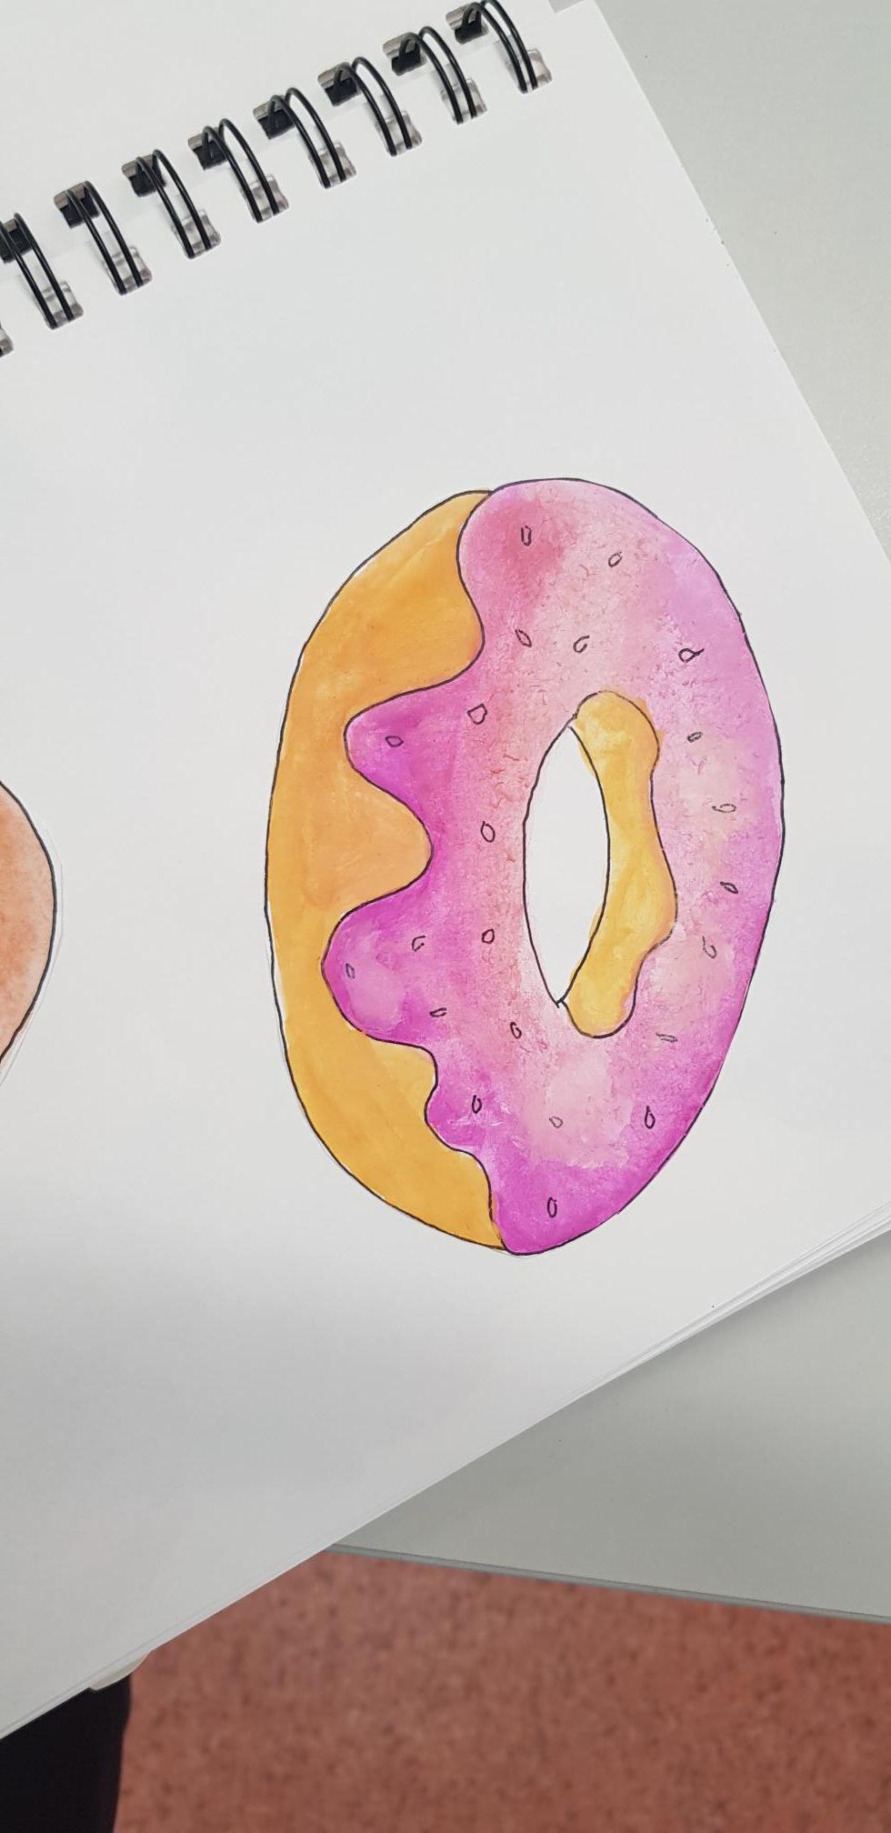

Why Art?
At Olive Academy Thurrock the Art curriculum is designed to inspire our students to grow their arts and leadership talents. We aim to support and encourage students of all levels and abilities and from all backgrounds and cultures to engage and participate in the arts.
We offer our students access to two qualifications:
Pathway 1: Art GCSE qualification.
Pathway 2: Arts Award certificates (Discover, Explore or Bronze levels).

Slide 3
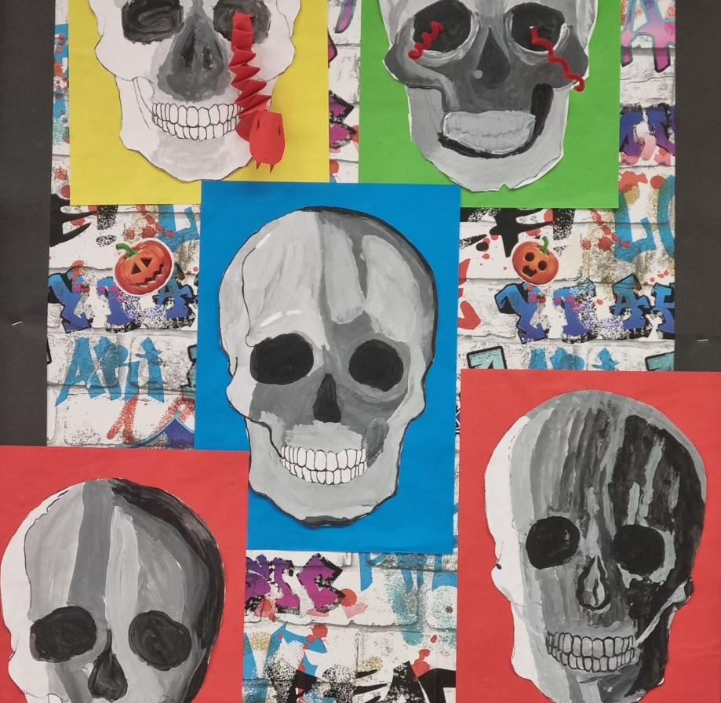
Art with KS3

Slide 4
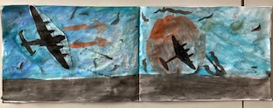
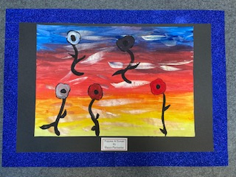
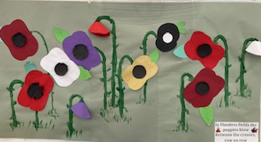
How do colours create mood?

Slide 5
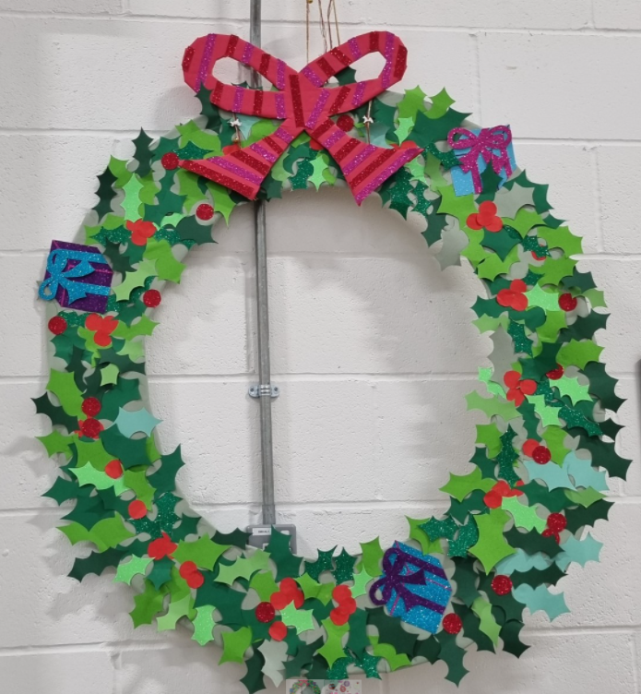
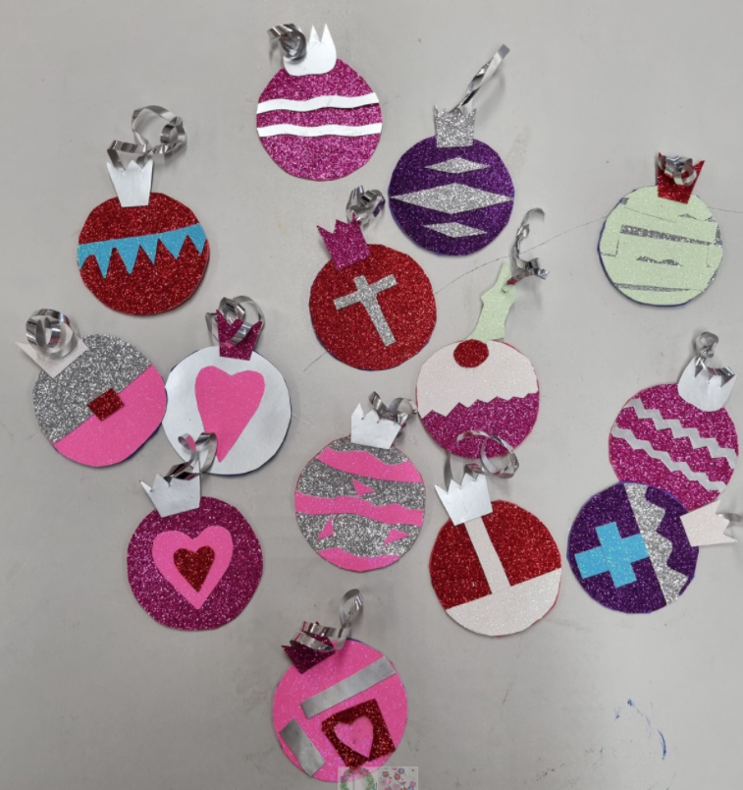
Preparing for the festive season with KS3

Slide 6
